Slide 1
2024-2025
Sophomore Presentation
Josh Gordon
College Access Specialist
jgordon@bisdtx.org

Slide 2
What will my school week look like?
Sophomores take classes at ACC Elgin on Tuesdays and Thursdays and are at CRCA on Mondays, Wednesdays, and Fridays.
Sophomores are enrolled in the following classes for the FALL semester:
•SPAN 1411- Spanish 1 (4 credits)
•DRAM 1310- Intro to Theatre (3 credits)

Slide 3
What will my school week look like?
Sophomores are enrolled in the following classes for the SPRING semester:
•SPAN 1412- Spanish 2 (4 credits)
•SPCH 1315- Public Speaking (3 credits)
(You cannot enroll in Spanish 2 without passing Spanish 1)

Slide 4
Satisfactory Academic
Progress
(SAP)
It is absolutely essential that you maintain or achieve the following in order to qualify for state and federal financial aid for your undergraduate college education:
A MINIMUM of 2.0 GPA
A MINIMUM of a 67% Completion Rate

Slide 5
ACC Sophomore Expectations
Mr. Gordon’s main responsibility is to assist you in transitioning from a K-12 student to an adult/ college student.
You must come to class prepared and ready to learn. This includes:
Bringing your laptop, fully charged, and your power cord
Keeping your phone and earbuds in your backpack
Using the restroom BEFORE going to class
Bringing and wearing your ACC ID
Photo Caption or Description

Slide 6
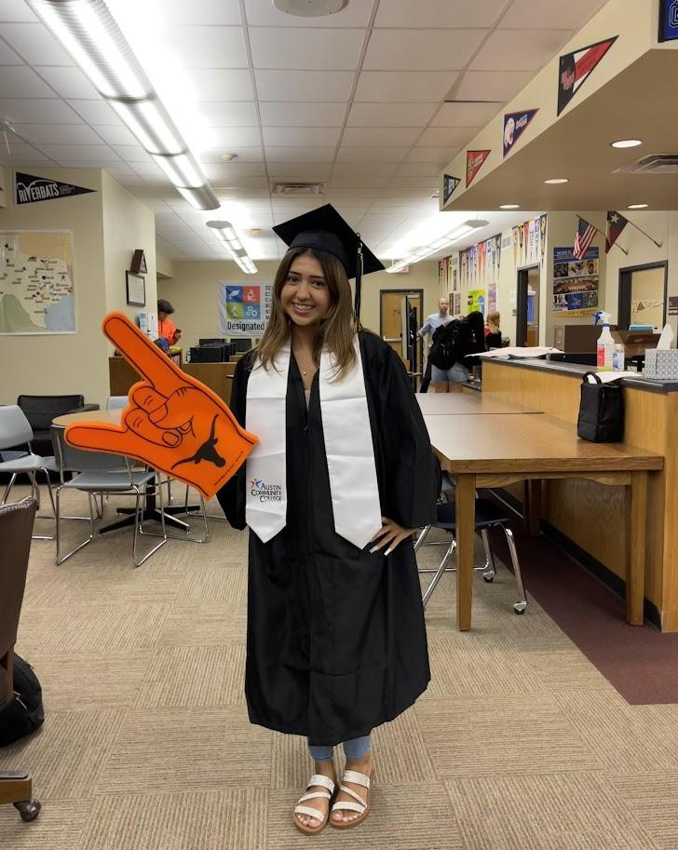
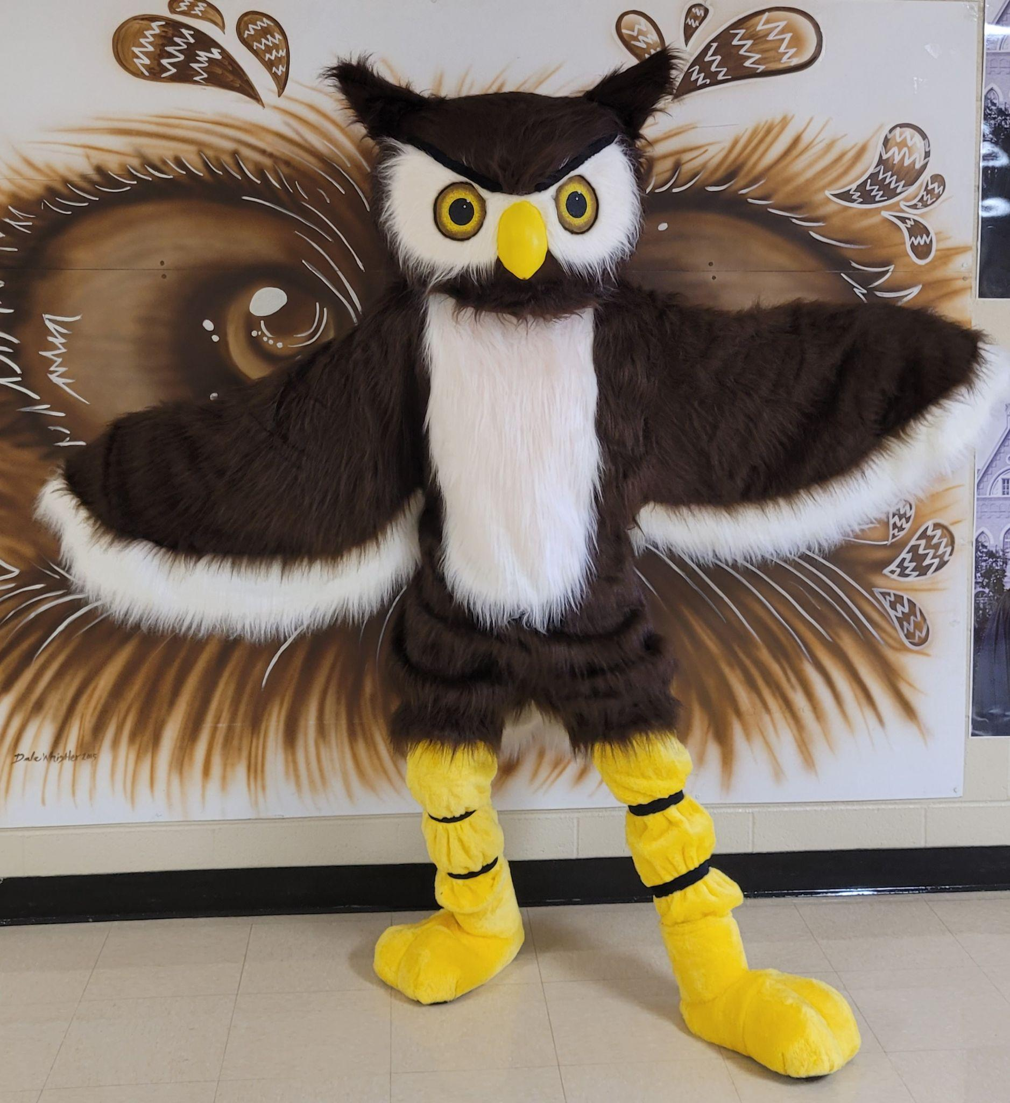
ACC Sophomore Expectations
The Bus leaves CRCA at 9:00 AM. If you are running late, please call the front office. You may be responsible for finding your own transportation to Elgin.
Keep the bus clean. If you don’t clean up your mess, I have to.
The bus will leave ACC at 1:55 PM from where Mr. Gordon drops you off.
Photo Caption or Description

Slide 7
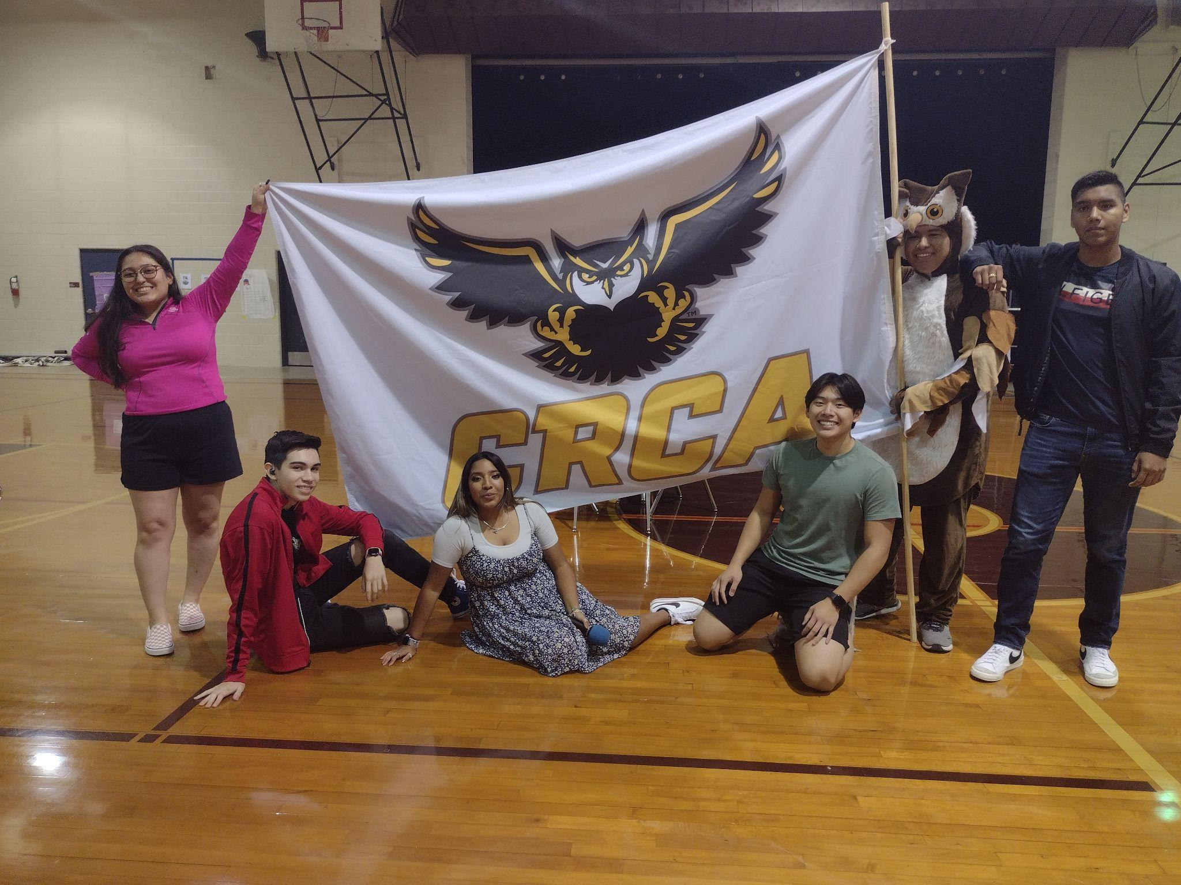
ACC Sophomore Expectations
Check your ACC emails and syllabus on a daily basis
Be aware of deadlines. Use a day planner
Be Prepared
Be On-time to class and only leave class if you absolutely have to.
Pay attention in class.
Photo Caption or Description

Slide 8
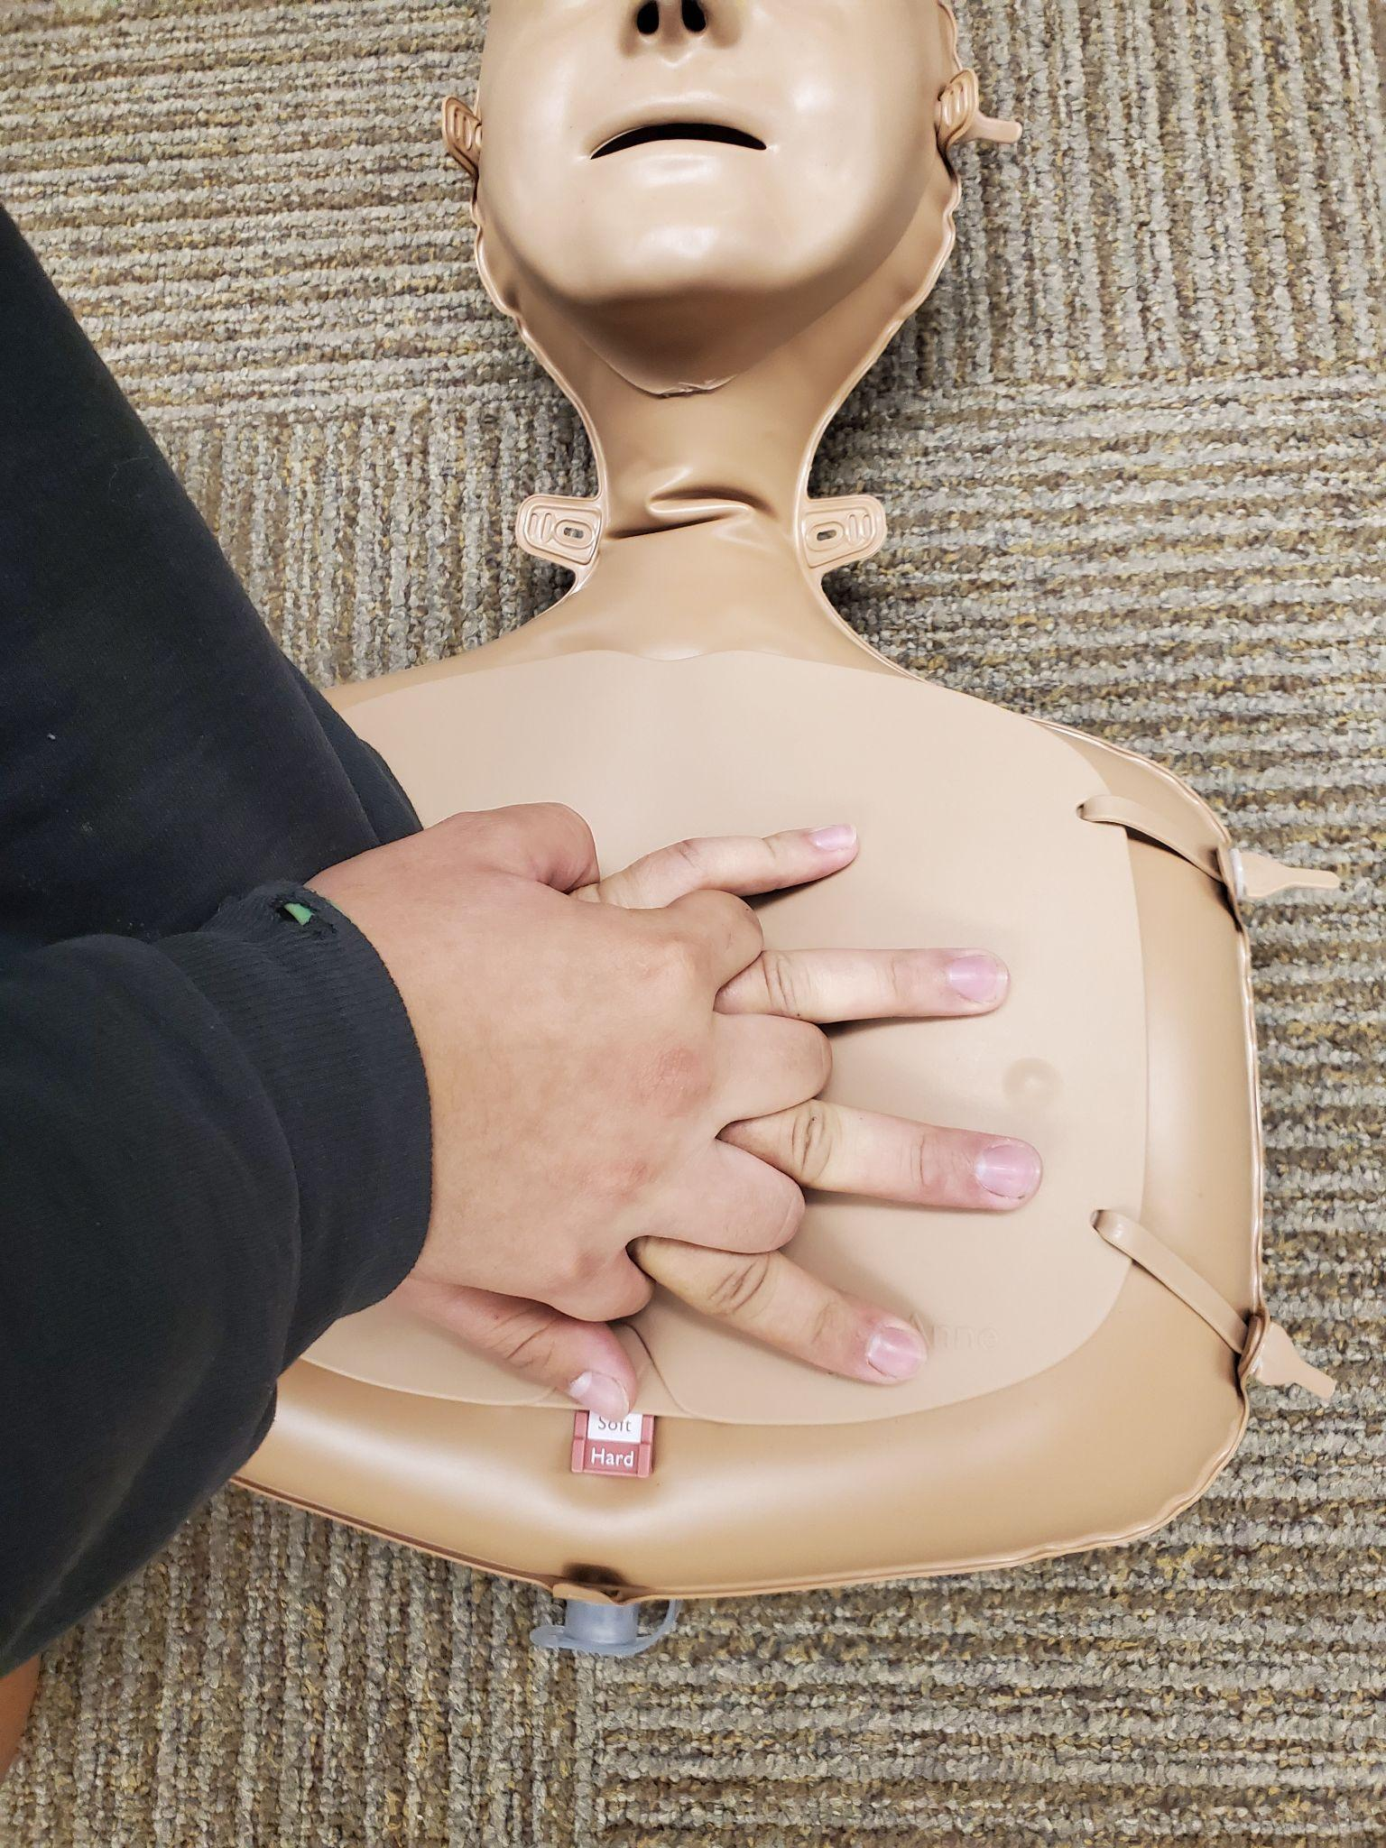
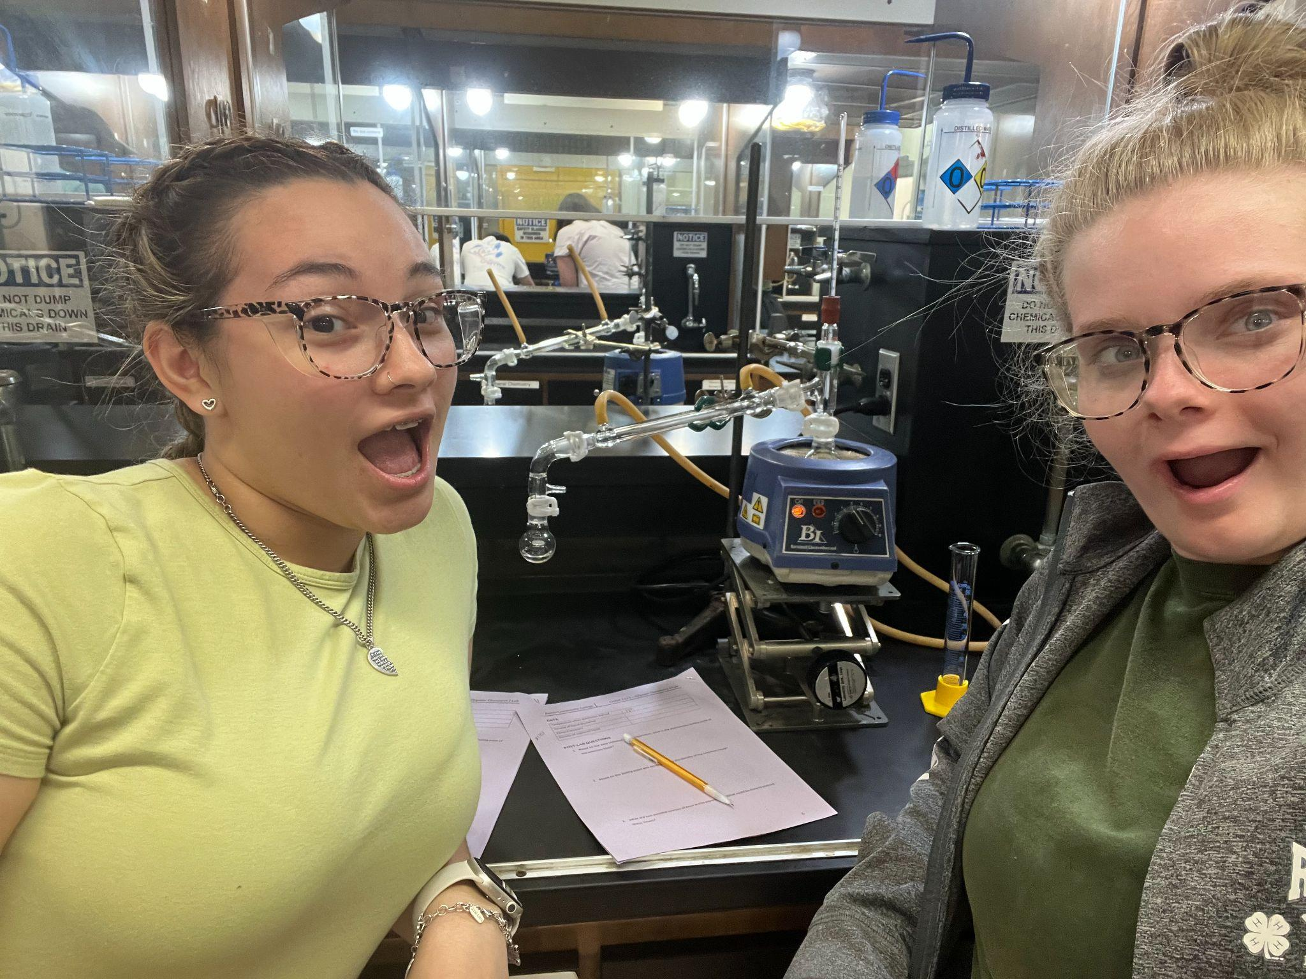
ACC Sophomore Expectations
No lunch is provided at ACC. If you would like a sack lunch, please speak with Mr. Gordon.
There are vending machines at ACC, but they can have long lines and be expensive.
Photo Caption or Description

Slide 9
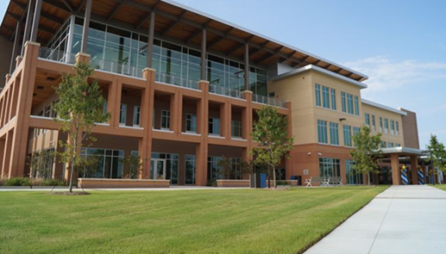
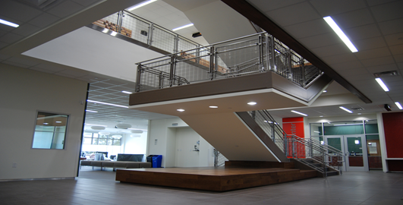
ACC Expectations
Library is on the 3rd floor
At ACC Elgin, you may be in the following areas:
The Library (on 3rd floor)
The Learning Lab (on 2nd floor)
The Student Life Center or in the breezeway outside of the Student Life Center (in the lobby)
The Computer Lab (on 2nd floor)
Student Services Office (on 1st floor)
Photo Caption or DescriptionMain
Main Stairwell

Slide 10
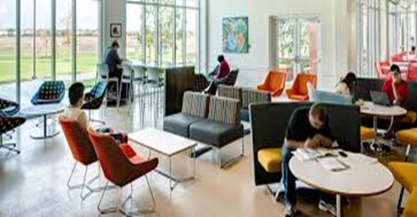
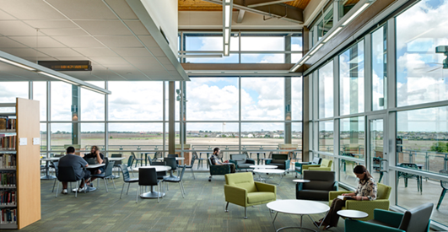
ACC Expectations
You may not leave ACC campus without first notifying CRCA front desk and Mr. Gordon (who can usually be found in the lobby or library).
This includes being picked up by a parent or guardian.
You may not hang out in the stairwell, outside of the main ACC building, or in your car in the parking lot.
Lobby
Photo Caption or DescriptionLibrary
Library

Slide 11
THANK YOU!
Are there any questions?

